Slide 1
Introduction to Machine Learning
Soumya Banerjee

Slide 2
Warm up
You have a 5-liter jug and a 3-liter jug. How can you measure exactly 4 liters of water using only these two jugs?

Slide 3
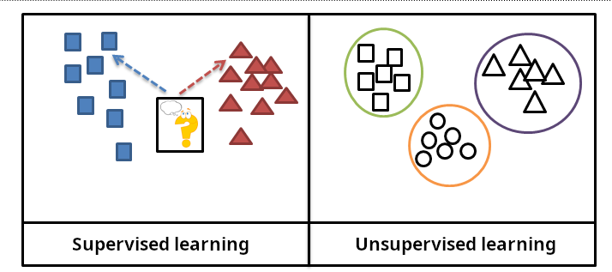
Types of Machine Learning
Slide courtesy Paul Fannon

Slide 4
Supervised Learning - Regression
Student | ML Trained? | Cohort %ile | Salary
0001 | Y | 12 | 120000
0002 | Y | 58 | 42000
0003 | N | 22 | 36000
0004 | Y | 58 | 35000
… | … | … | …
1784 | Y | 34 | ???
Slide courtesy Paul Fannon

Slide 5
Unsupervised methods
History
Exploratory data analysis
Hypothesis generation
Data visualization
Data imputation
Detecting outliers
Notes:
Slide on single-cell rna seq tsne xx
Slide on bulk seq data

Slide 6
High-dimensional data
How to visualize high-dimensional data
Pairwise

Slide 7

High-dimensional data
https://stats.stackexchange.com/questions/2691/making-sense-of-principal-component-analysis-eigenvectors-eigenvalues

Slide 8


Interactive tool
https://projector.tensorflow.org/

Slide 9
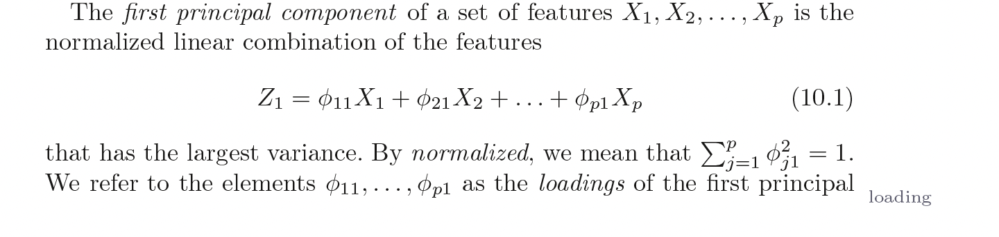
PCA
Introduction to Statistical Learning in R

Slide 10
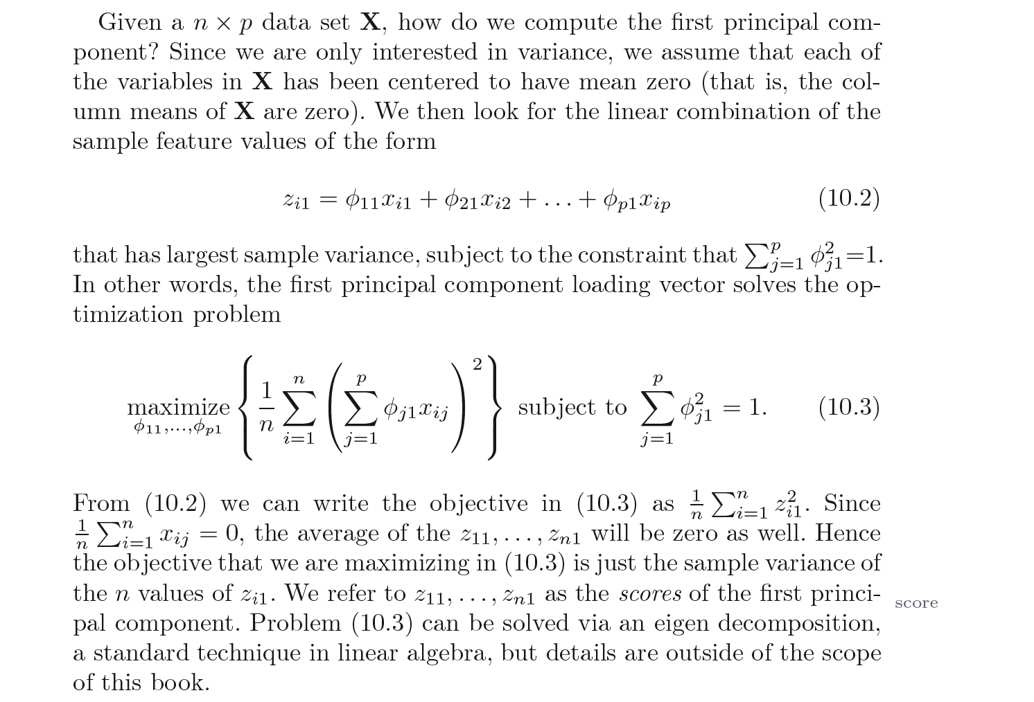
PCA
Introduction to Statistical Learning in R

Slide 11
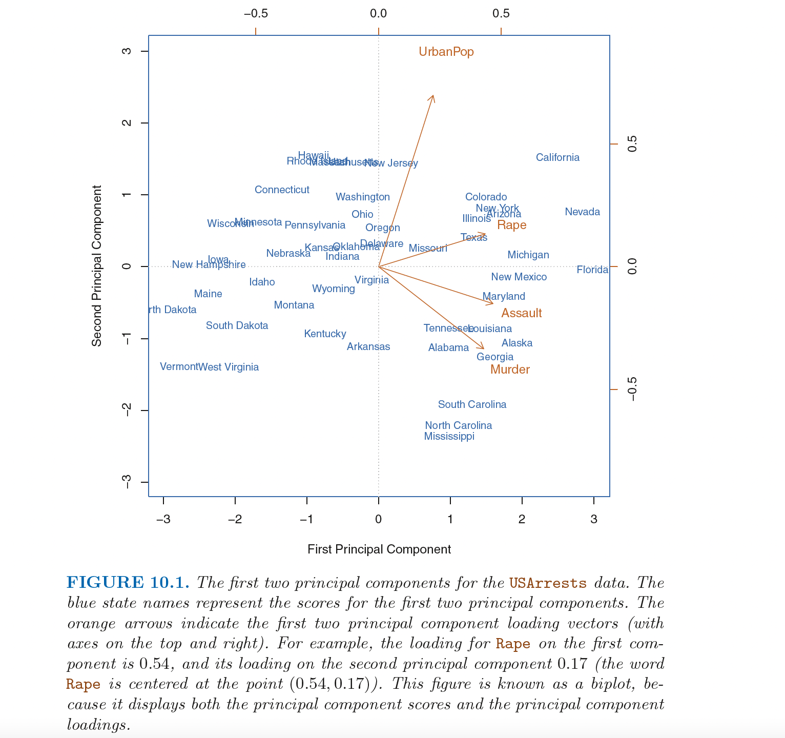

Slide 12
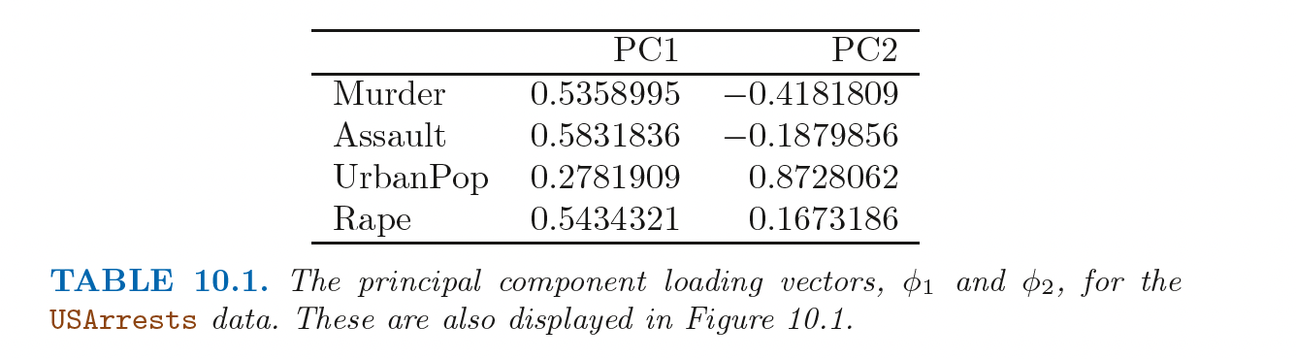
PCA
Introduction to Statistical Learning in R

Slide 13
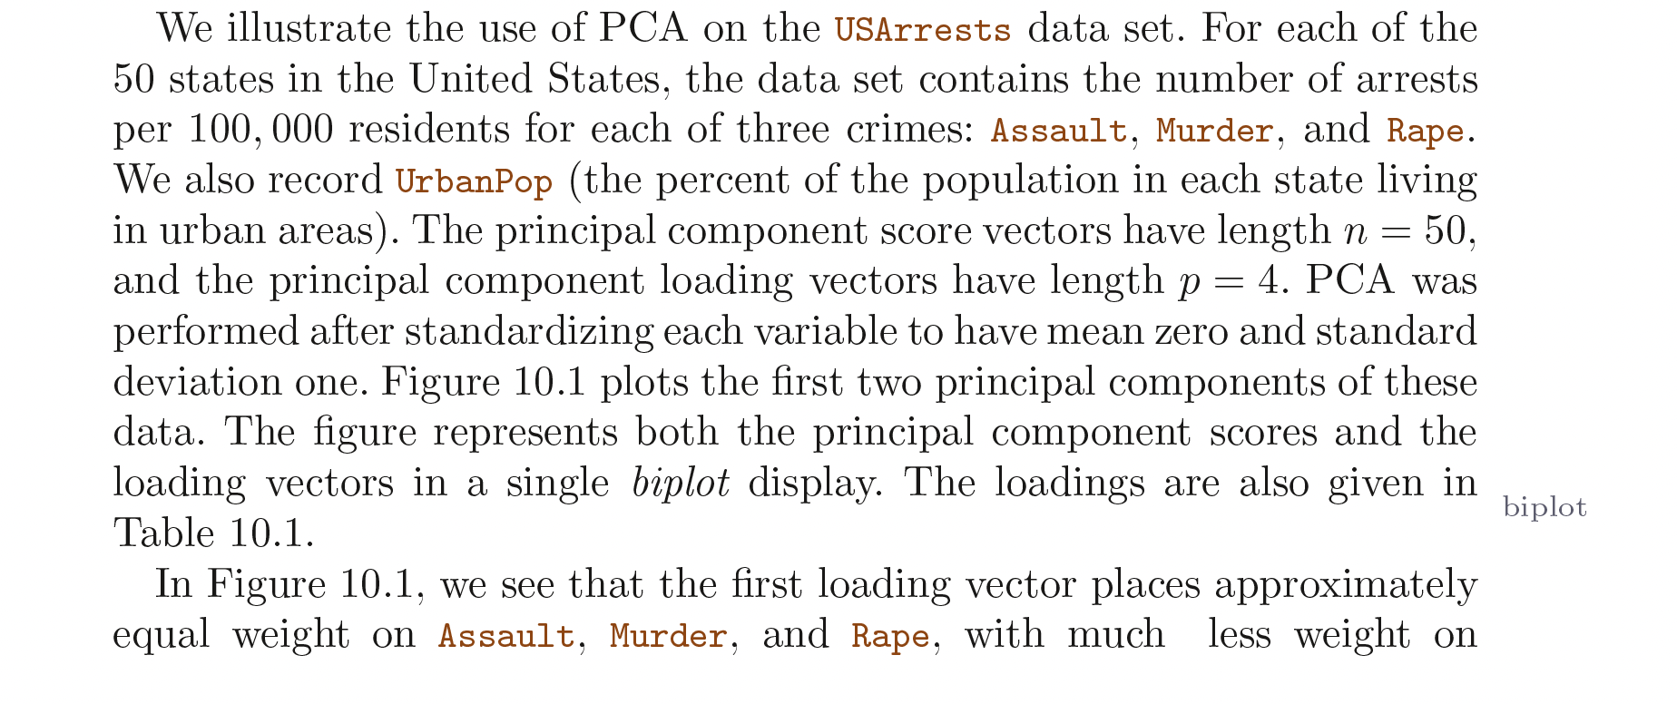
PCA
Introduction to Statistical Learning in R

Slide 14
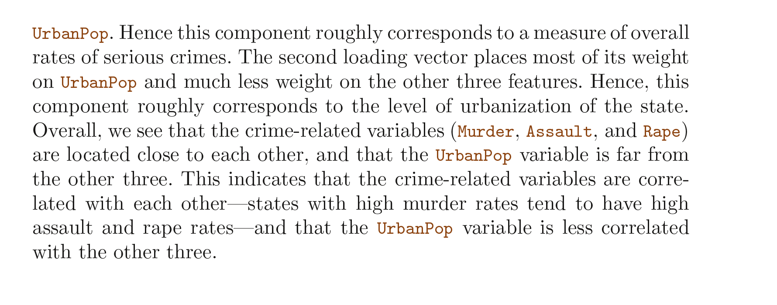
PCA
Introduction to Statistical Learning in R

Slide 15
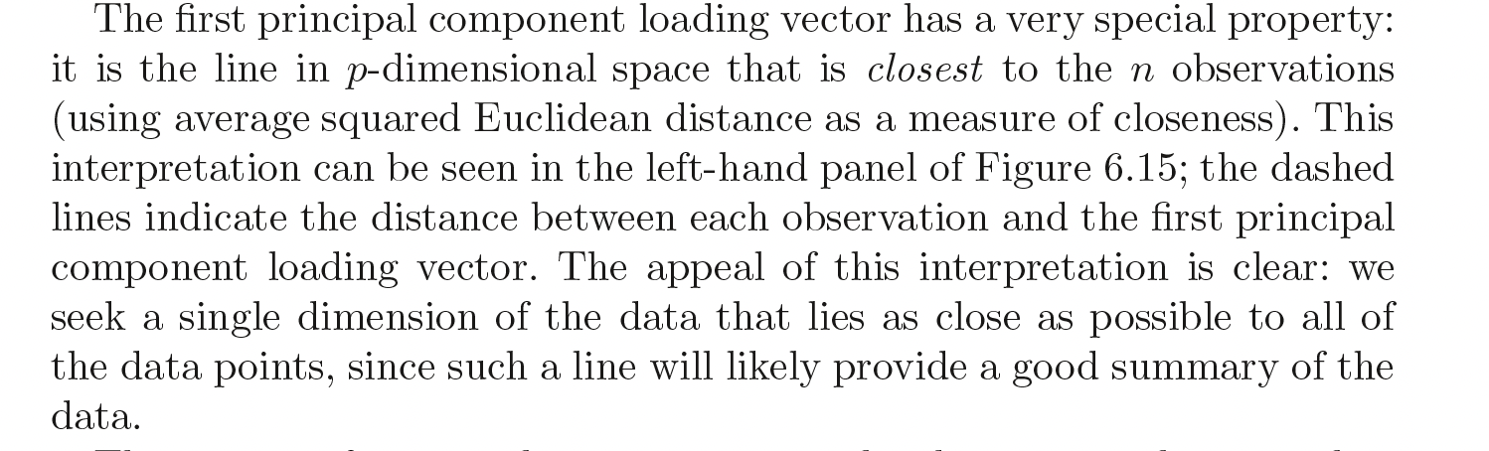
PCA
Introduction to Statistical Learning in R

Slide 16
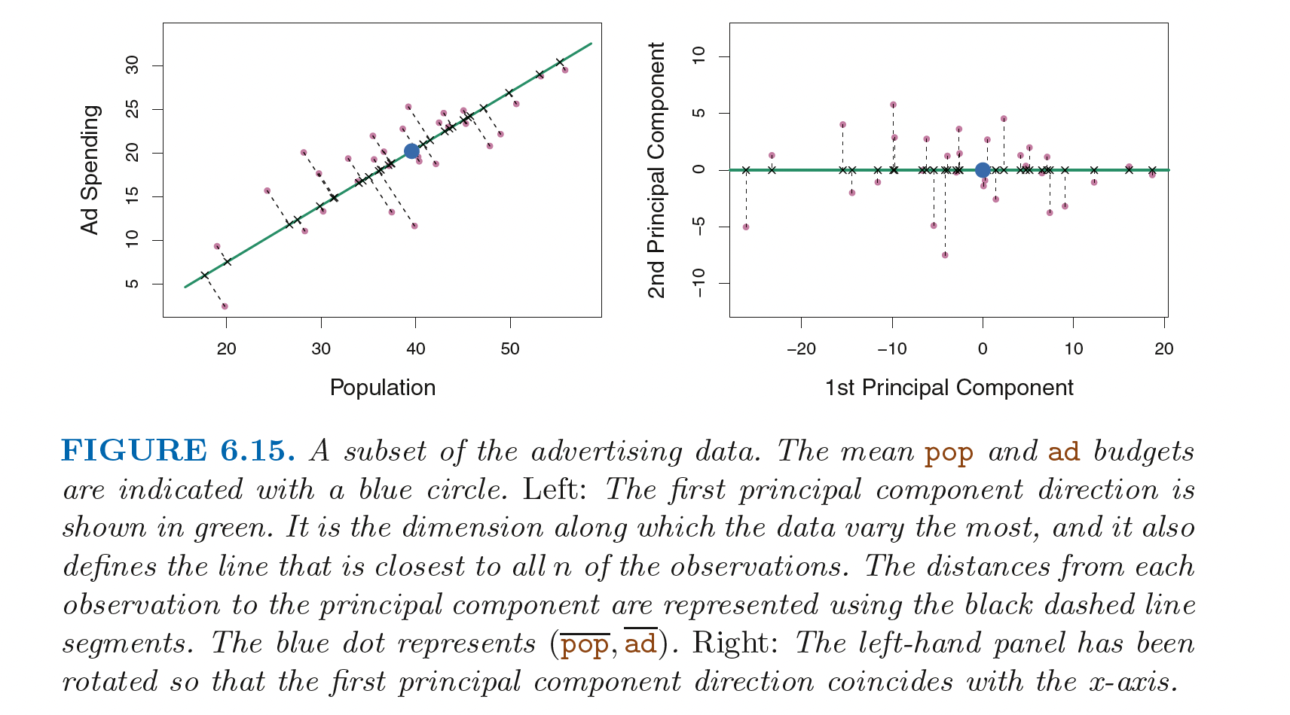
PCA
Introduction to Statistical Learning in R

Slide 17
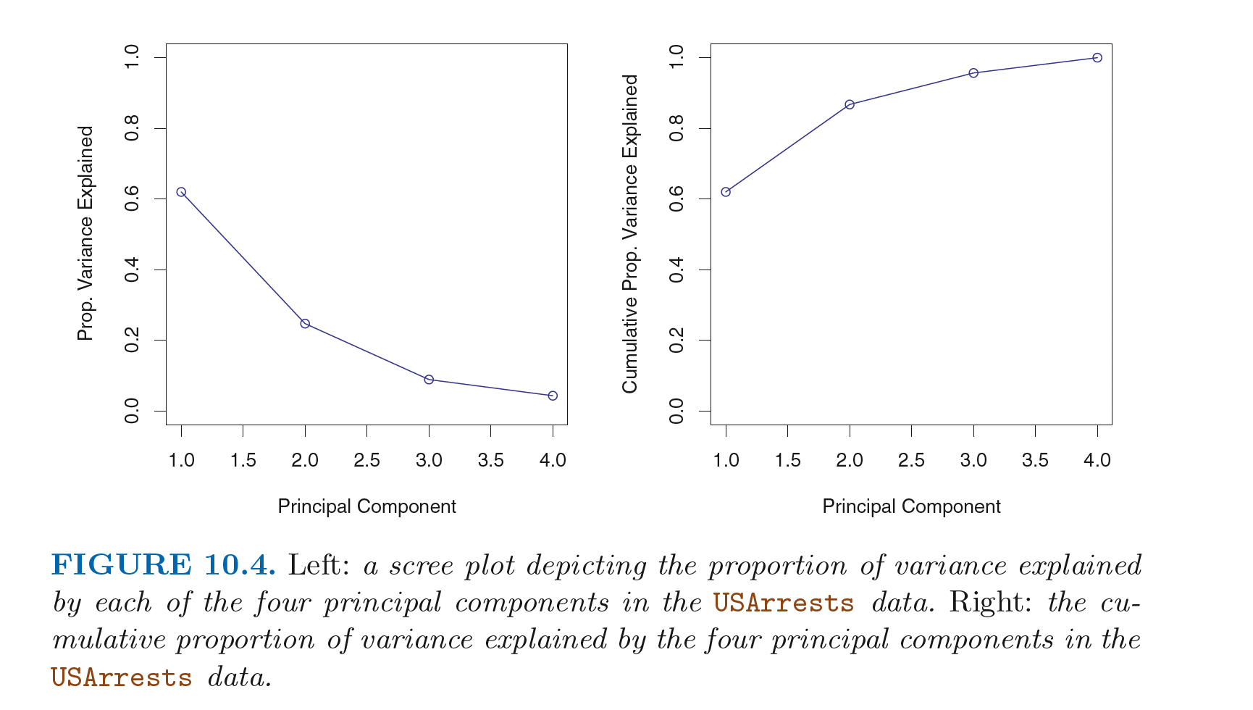
Scree plots (PRACTICAL)
Introduction to Statistical Learning in R

Slide 18
Non-linear
How to make a non-linear dimensionality reduction technique?

Slide 19

Important concept
Information bottleneck
Notes:
This is how you achieve word embedding

Slide 20
generalizations of this idea
tSNE
Autoencoder (non-linear loss function)

Slide 21
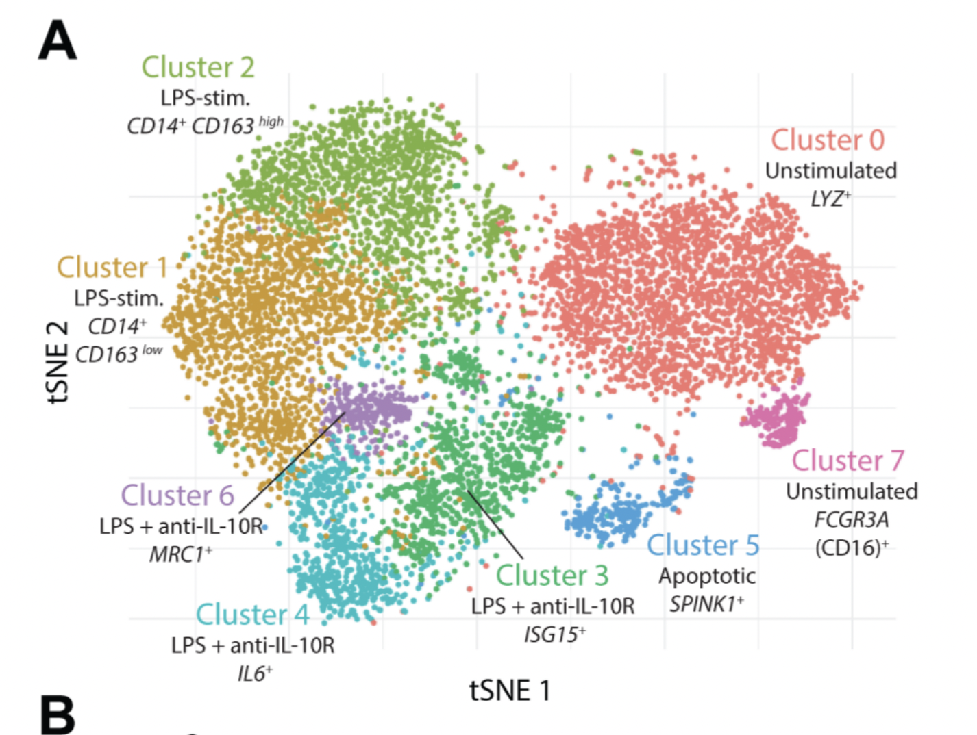
Case study
a. stochastic b. distances not preserved c. difficult to communicate to non-technical experts
Notes:
Example of IL10 project (tSNE and heatmaps from a bioinformatics project)

Slide 22
Visualizations can be misleading
1. distances not preserved in tsne
https://distill.pub/2016/misread-tsne/ 2. cluster sizes do not matter 3. you can see some shapes sometimes
4. random does not always look random
Notes:
Example of IL10 project (tSNE and heatmaps from a bioinformatics project)

Slide 23
1. problems with communicating high dimensional data 2. High dimensions are difficult to visualize
Visualizing high-dimensions
Notes:
Example of IL10 project (tSNE and heatmaps from a bioinformatics project)

Slide 24

Case study
Notes:
Example of IL10 project (tSNE and heatmaps from a bioinformatics project)

Slide 25

Case study
Notes:
Can anyone guess why this map is distorted?

Slide 26

Area proportional to number of vaccine doses
Notes:
Maps of the global distribution of seasonal influenza vaccine in the year 2013. Data for vaccine doses are from Palache et al. (2015). Region boundaries and population data are sourced directly from the R package rnaturalearthhires (South, 2020), which uses boundaries based on de facto status. We do not adopt a political stance on these boundaries. (a) Choropleth map based on the Hobo-Dyer equal-area projection. (b) Choropleth cartogram where countries are depicted with an area in proportion to the number of vaccine doses.

Slide 27
cartograms
https://go-cart.io/tutorial
Notes:
Can anyone guess why this map is distorted?

Slide 28
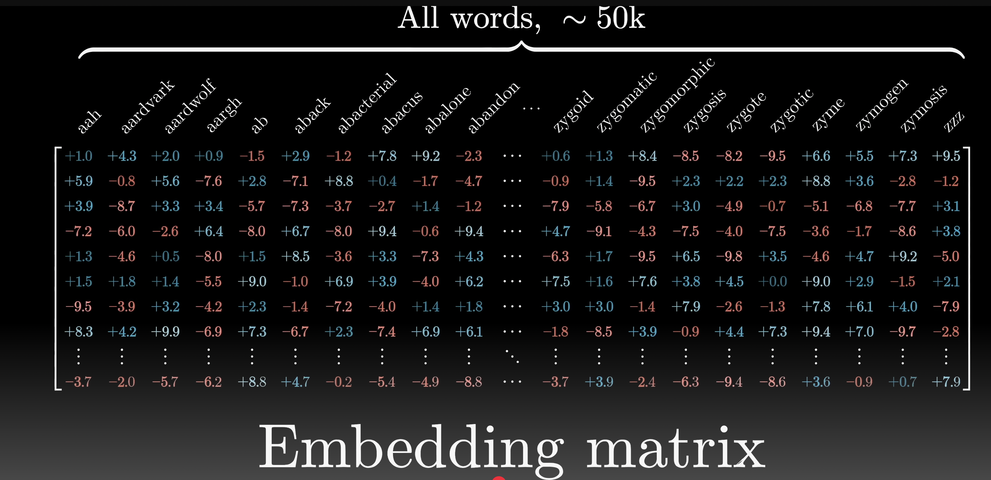
Applications to Large-Language Models
Video by 3blue1brown
Notes:
See autoencoder slide on how to achieve this

Slide 29
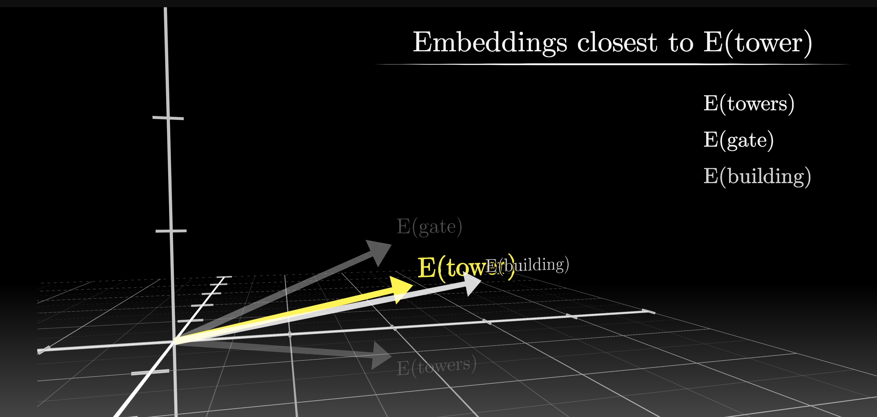
Applications to Large-Language Models
Video by 3blue1brown

Slide 30
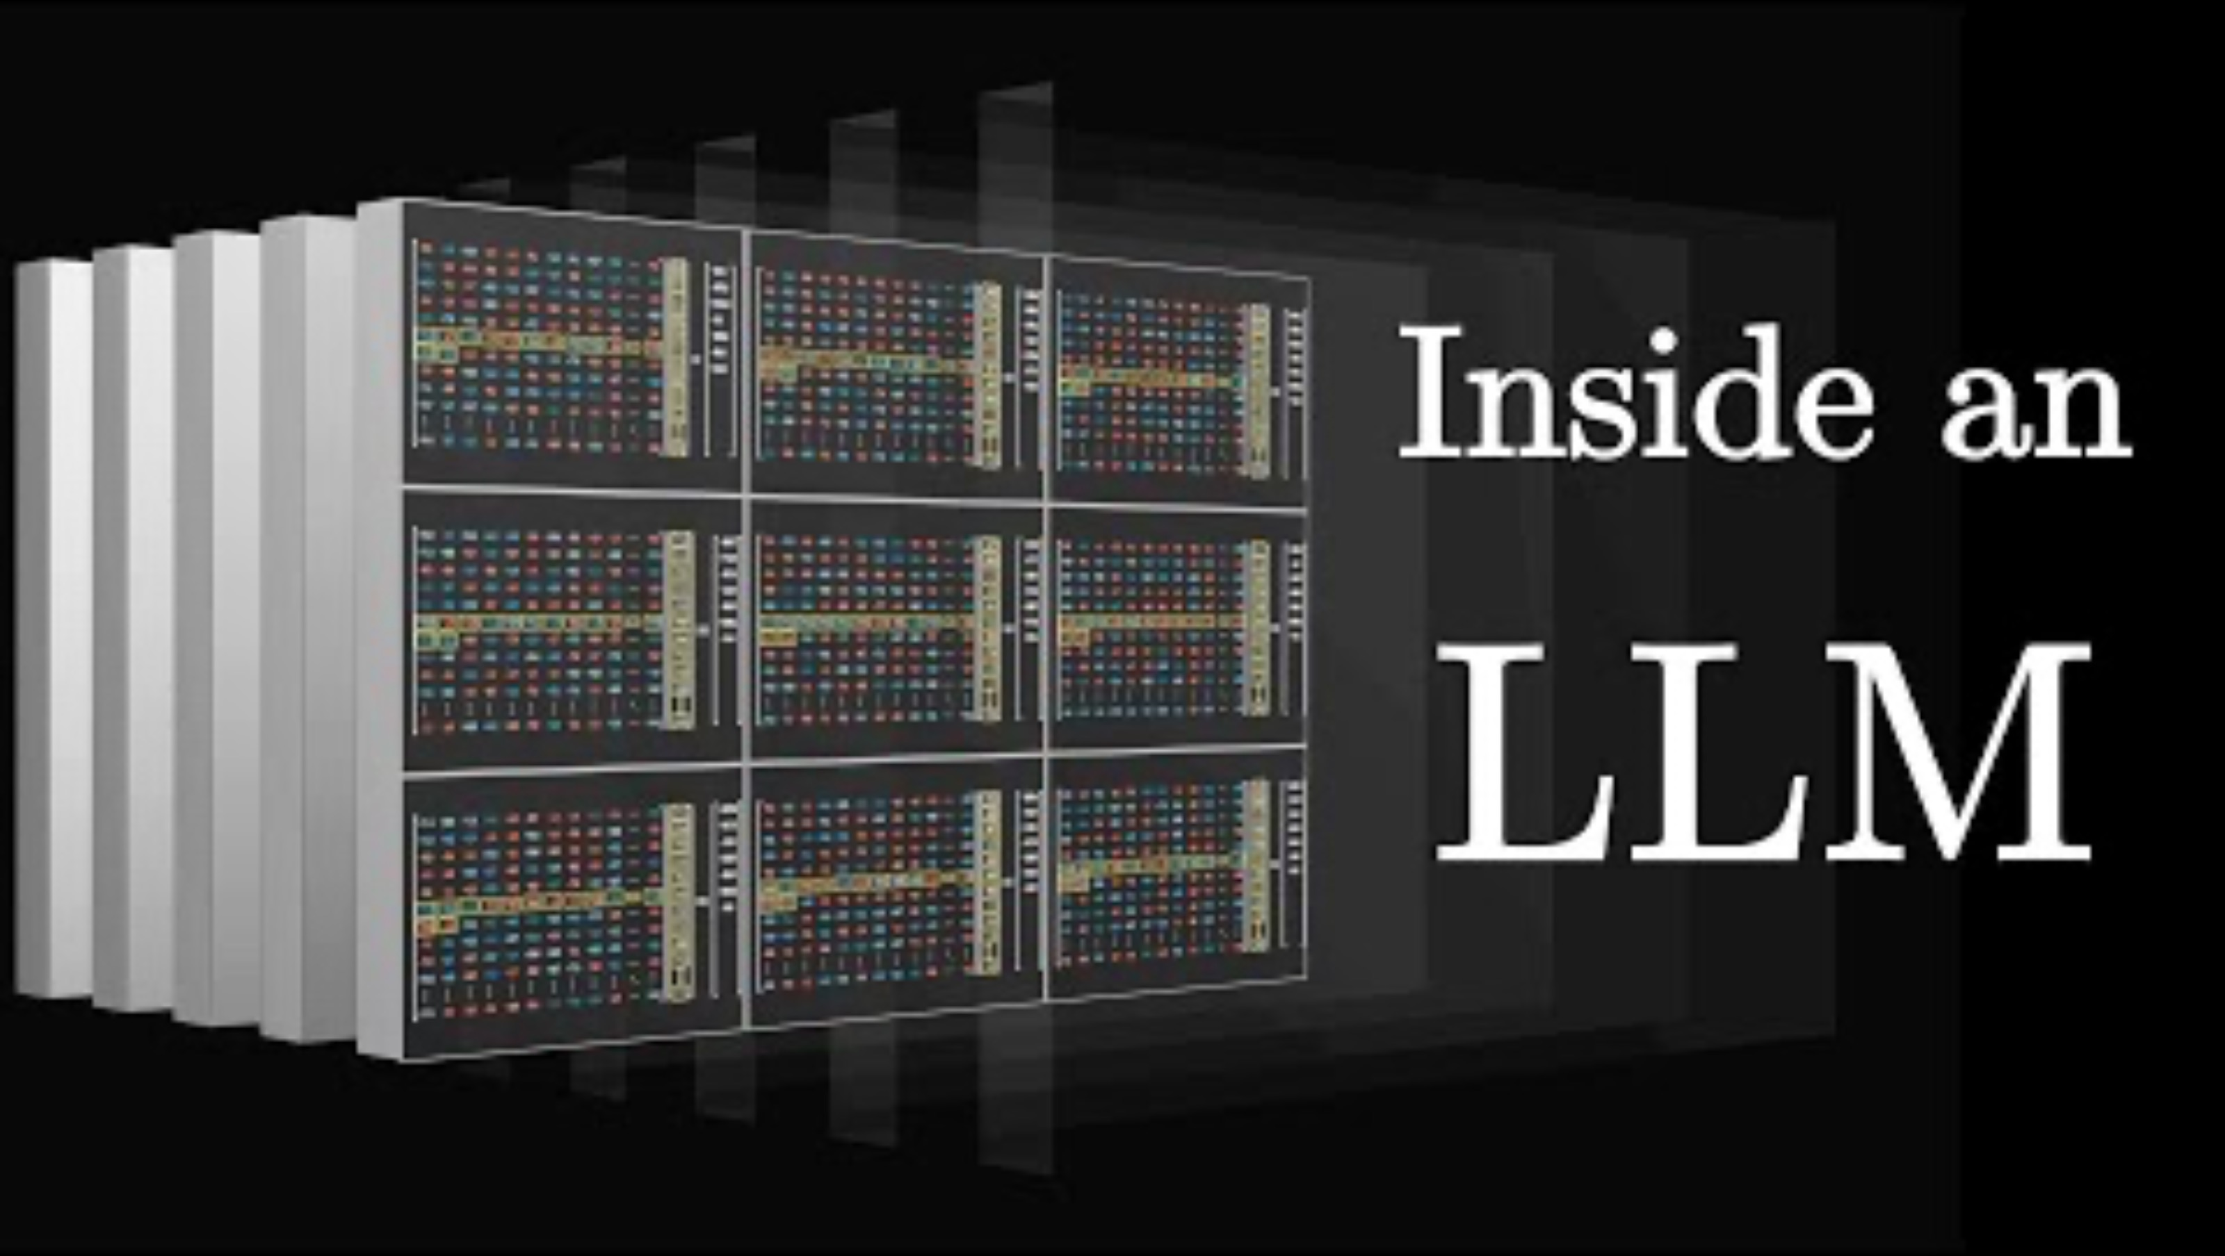
Applications to Large-Language Models
Video by 3blue1brown

Slide 31
Real life
In real life, there are no clear distinctions between unsupervised and supervised machine learning
You tend to use both
Or combine both (semi-supervised)
Notes:
You can encode words as vectors, reduce dimensionality and then use it in a neural network

Slide 32
Come back to the puzzle
You have a 5-liter jug and a 3-liter jug. How can you measure exactly 4 liters of water using only these two jugs?
Solution?
Now what if both jugs have the same base diameter (but different heights). Can you solve the problem using fewer steps?
Notes:
You can encode words as vectors, reduce dimensionality and then use it in a neural network

Slide 33
K means Clustering

Slide 34
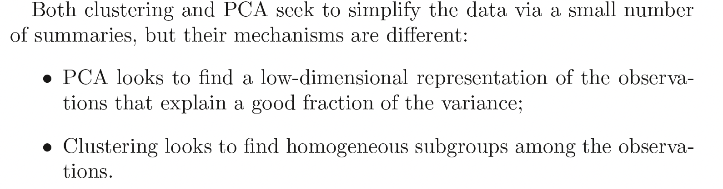
Clustering
Introduction to Statistical Learning in R

Slide 35
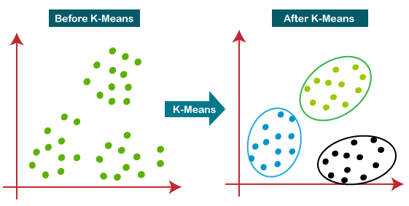
K-means Clustering

Slide 36
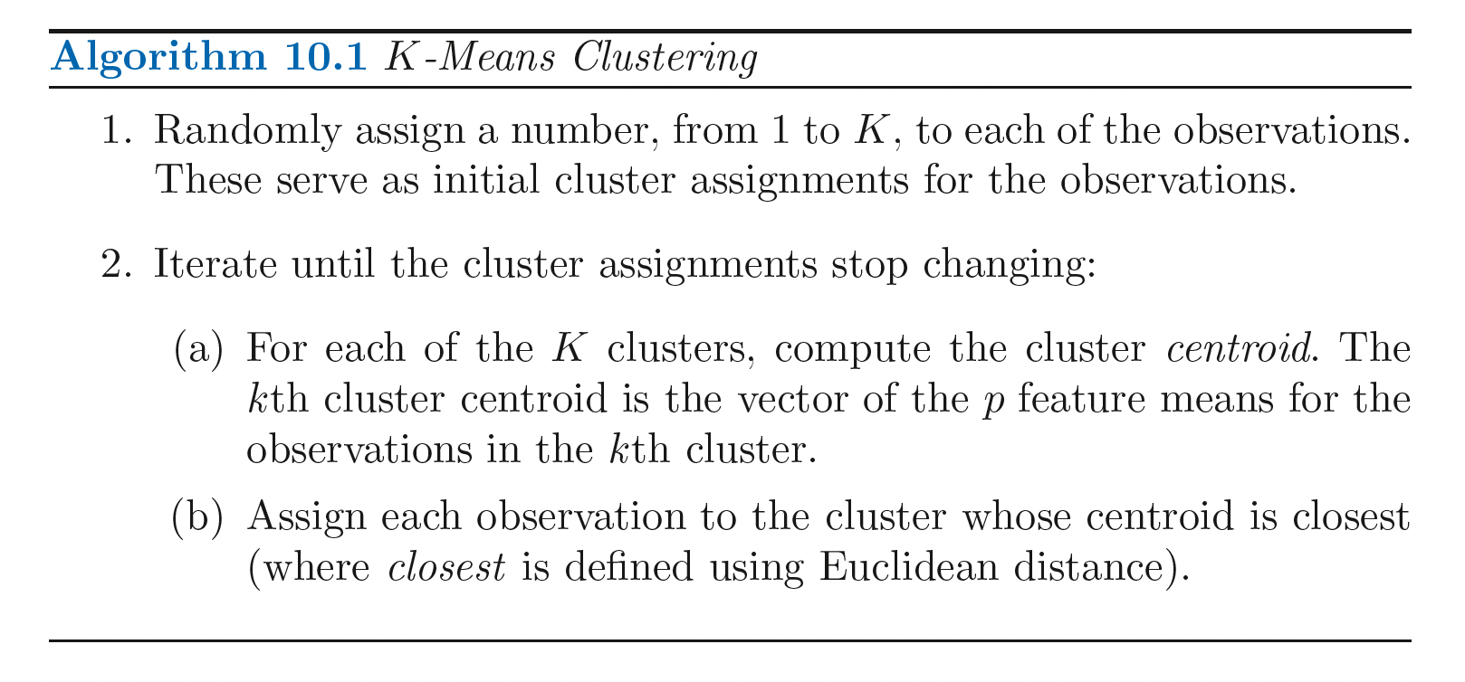
K-means Clustering
Introduction to Statistical Learning in R

Slide 37
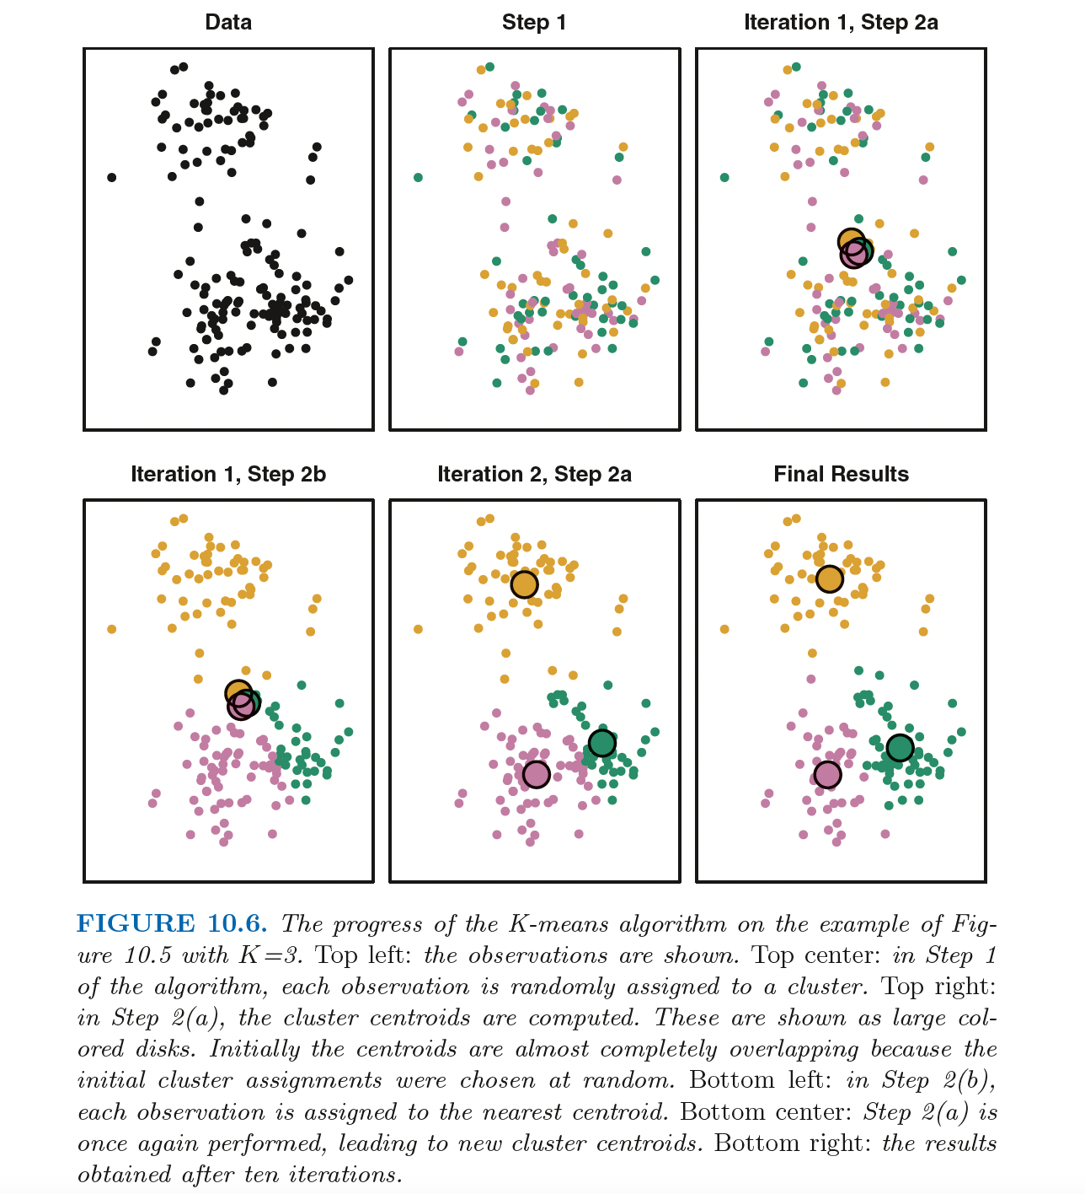

Slide 38
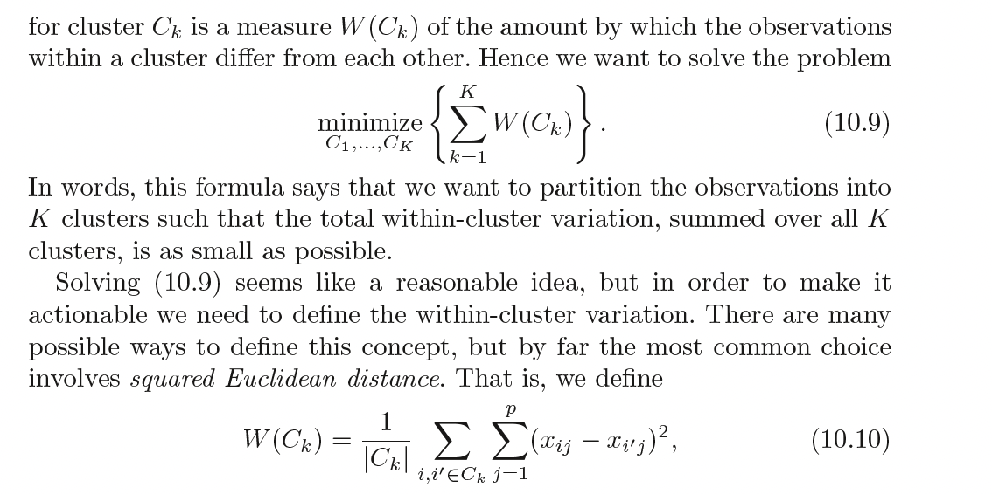
Introduction to Statistical Learning in R

Slide 39
K-means Clustering
1. Assign each data point to their closest centroid.
2. Work out the mean of each resulting cluster and make this the new centroid.
https://www.youtube.com/watch?v=5I3Ei69I40s&ab_channel=bitLectures
https://www.youtube.com/watch?v=R2e3Ls9H_fc

Slide 40
K-means Clustering
How to apply this to high-dimensional data (more than 2 variables/features)
How to visualize the result of k-means on this data?

Slide 41
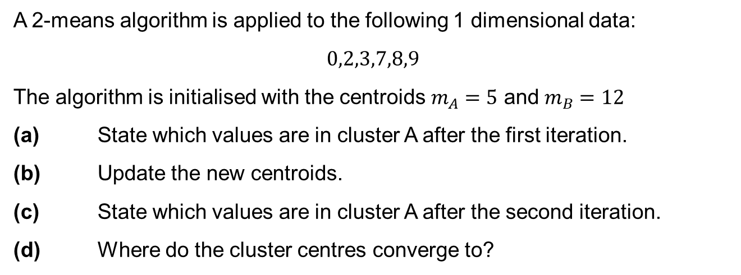
K means example
A 2-means algorithm is applied to the following 1 dimensional data:
$$0,2,3,7,8,9$$
The algorithm is initialised with the centroids $m_{A}=5$ and $m_{B}=12$
(a) State which values are in cluster A after the first iteration.
(b) Update the new centroids.
(c) State which values are in cluster A after the second iteration.
(d) Where do the cluster centres converge to?
Slide courtesy Paul Fannon

Slide 42
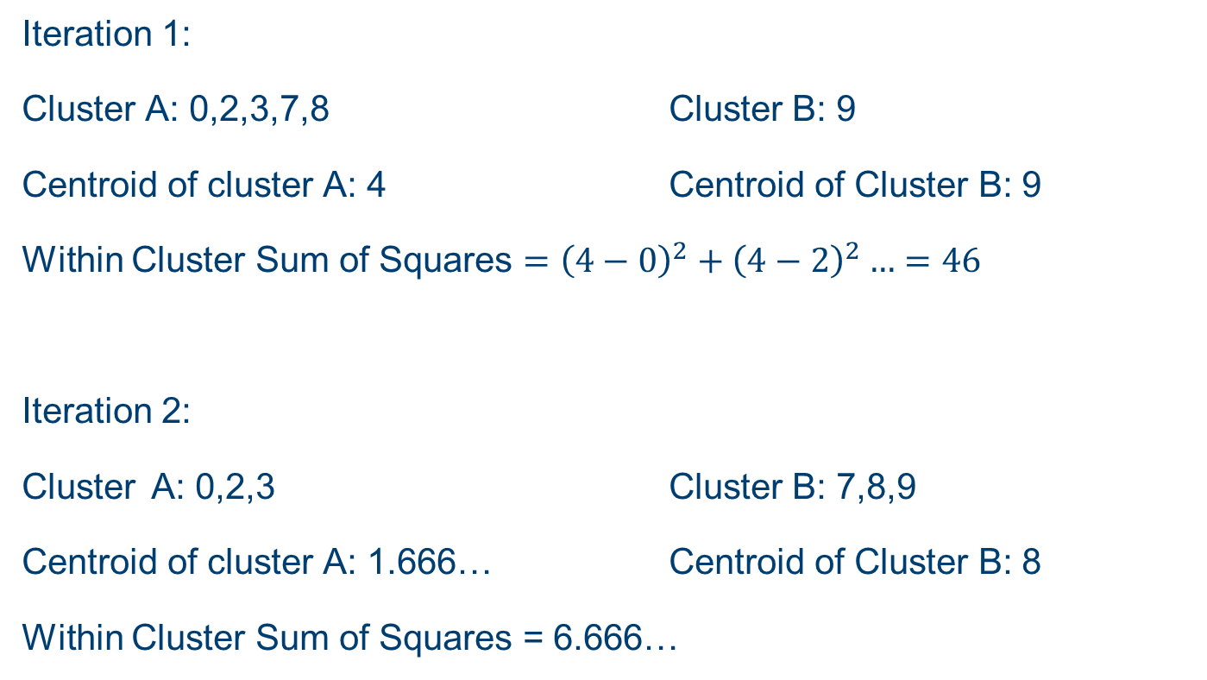
K means example
Iteration 1:
Cluster A: 0,2,3,7,8 Cluster B: 9
Centroid of cluster A: 4 Centroid of Cluster B: 9
Within Cluster Sum of Squares $={\left(4−0\right)}^{2}+{\left(4−2\right)}^{2}…=46$
Iteration 2:
Cluster A: 0,2,3 Cluster B: 7,8,9
Centroid of cluster A: 1.666… Centroid of Cluster B: 8
Within Cluster Sum of Squares = 6.666…
Slide courtesy Paul Fannon

Slide 43
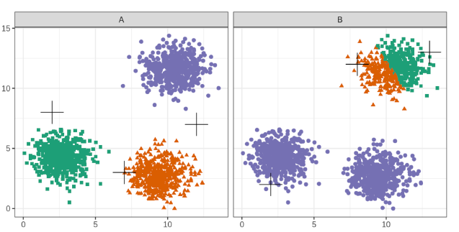
Choice of initial centroids
Slide courtesy Paul Fannon

Slide 44
Choosing k
Slide courtesy Paul Fannon

Slide 45
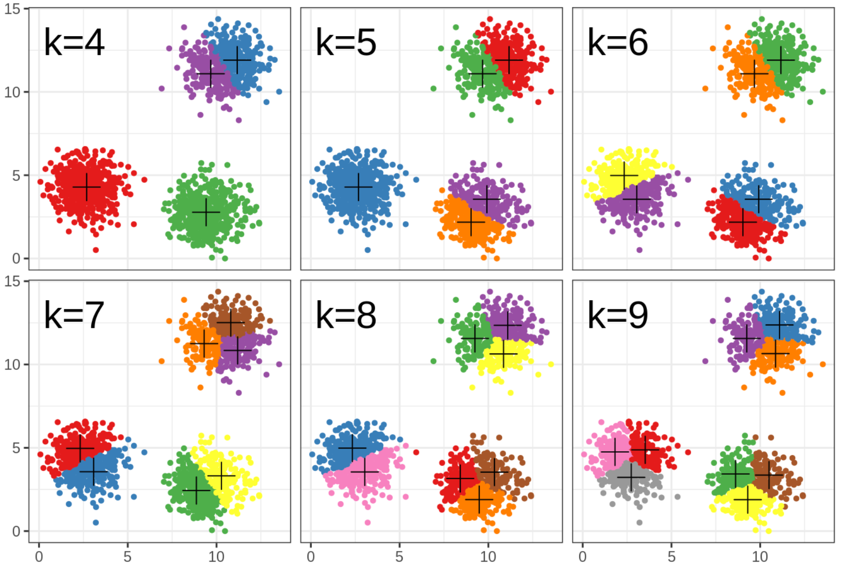
Choosing k
Slide courtesy Paul Fannon

Slide 46
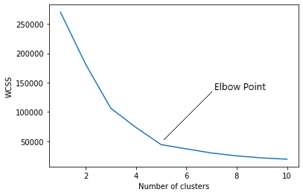
How to find the value of K
Slide courtesy Paul Fannon

Slide 47
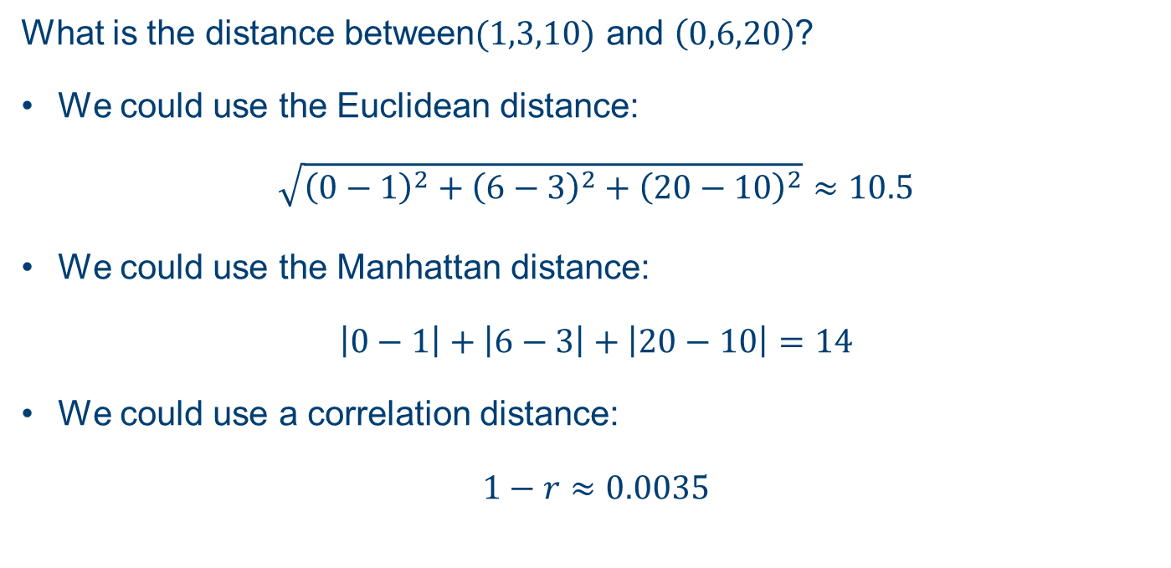
Clustering Distances
What is the distance between$(1,3,10)$ and $\left(0,6,20\right)$?
We could use the Euclidean distance:
$$\sqrt{{\left(0−1\right)}^{2}+{\left(6−3\right)}^{2}+{\left(20−10\right)}^{2}}≈10.5$$
We could use the Manhattan distance:
$$\left|0−1\right|+\left|6−3\right|+\left|20−10\right|=14$$
We could use a correlation distance:
$$1−r≈0.0035$$
Slide courtesy Paul Fannon

Slide 48
Hierarchical Clustering

Slide 49
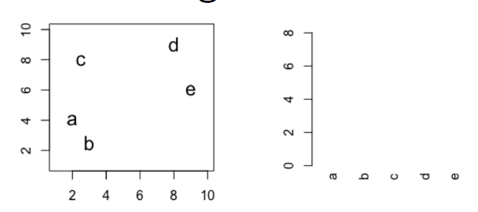
Hierarchical clustering
Slide courtesy Paul Fannon

Slide 50
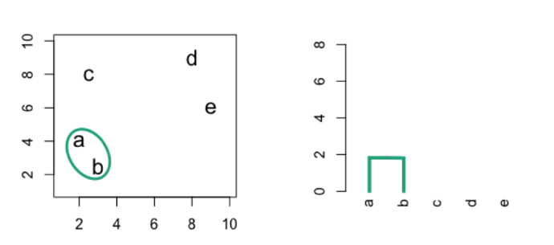
Hierarchical clustering
Slide courtesy Paul Fannon

Slide 51
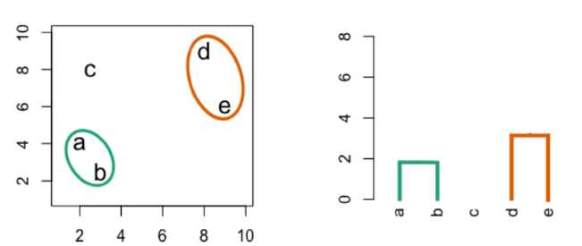
Hierarchical clustering
Slide courtesy Paul Fannon

Slide 52
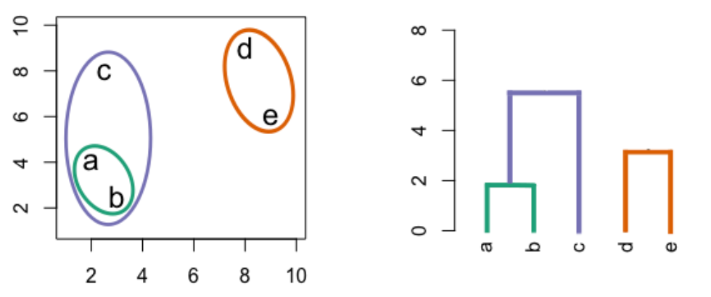
Hierarchical clustering
Slide courtesy Paul Fannon

Slide 53
Hierarchical clustering
Slide courtesy Paul Fannon

Slide 54
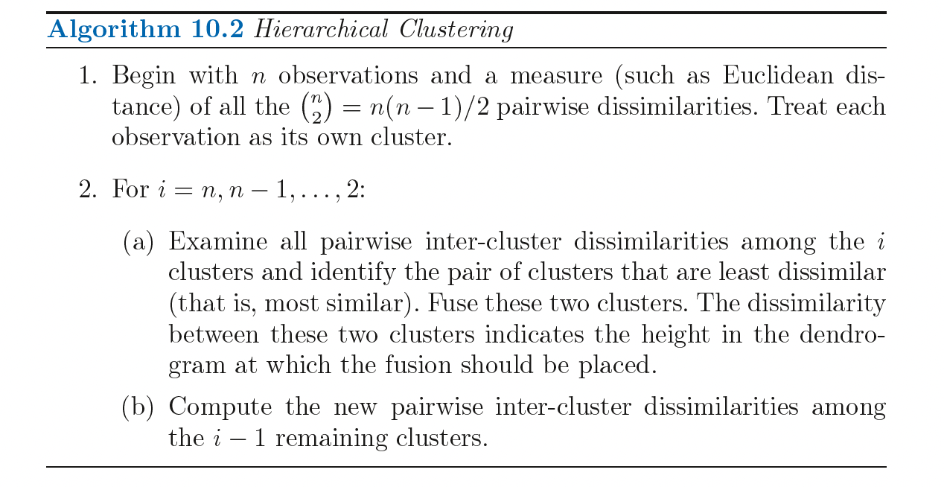
Hierarchical clustering

Slide 55
Dissimilarity measures
Euclidean distance
Correlation based distance

Slide 56
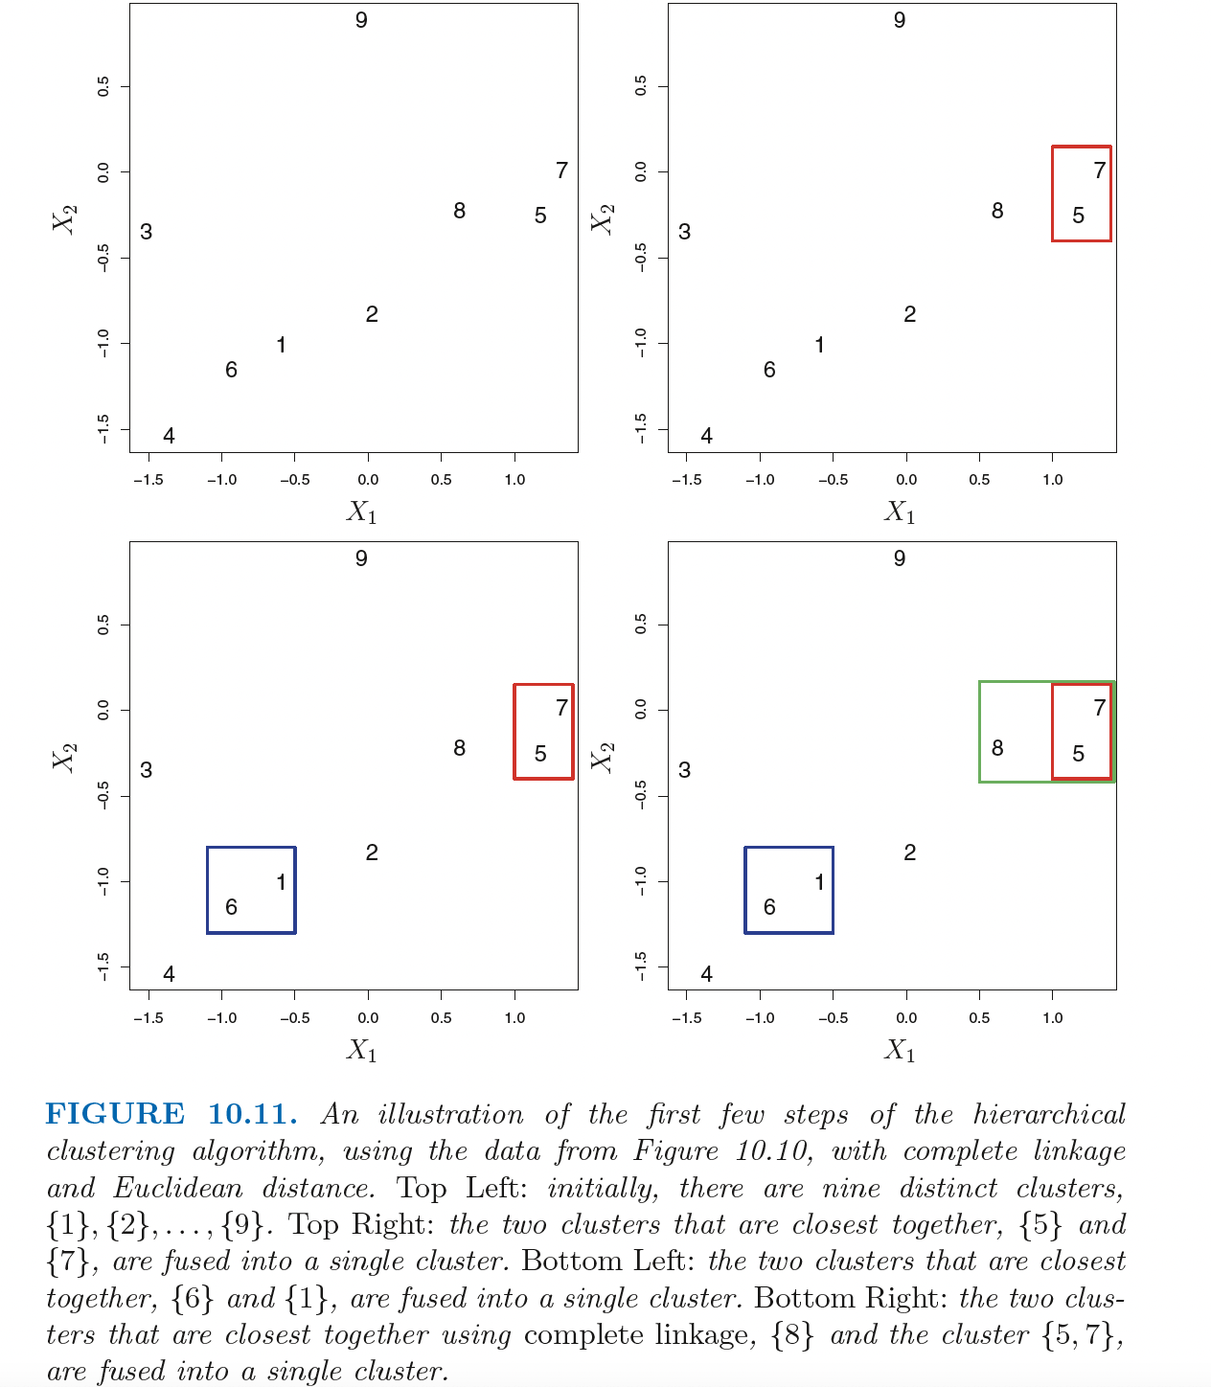
Dissimilarity measures

Slide 57
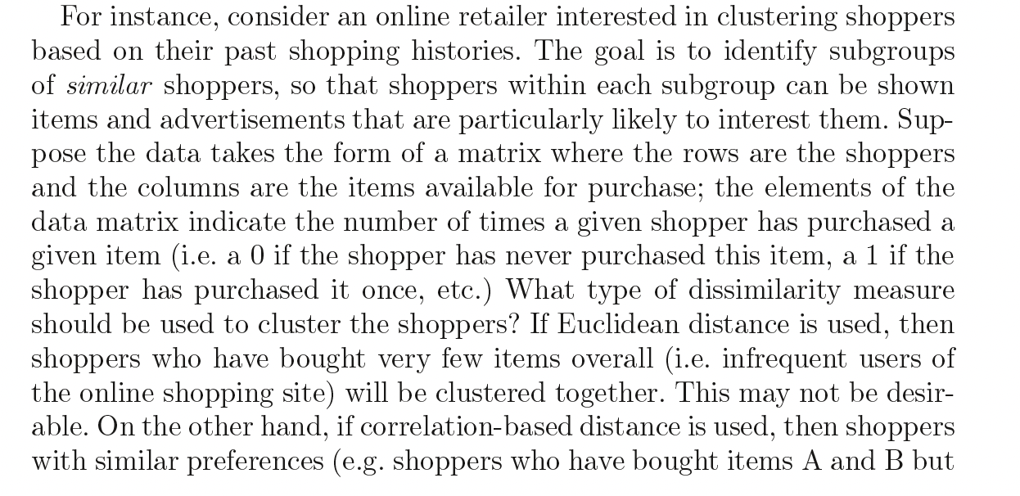
Dissimilarity measures

Slide 58
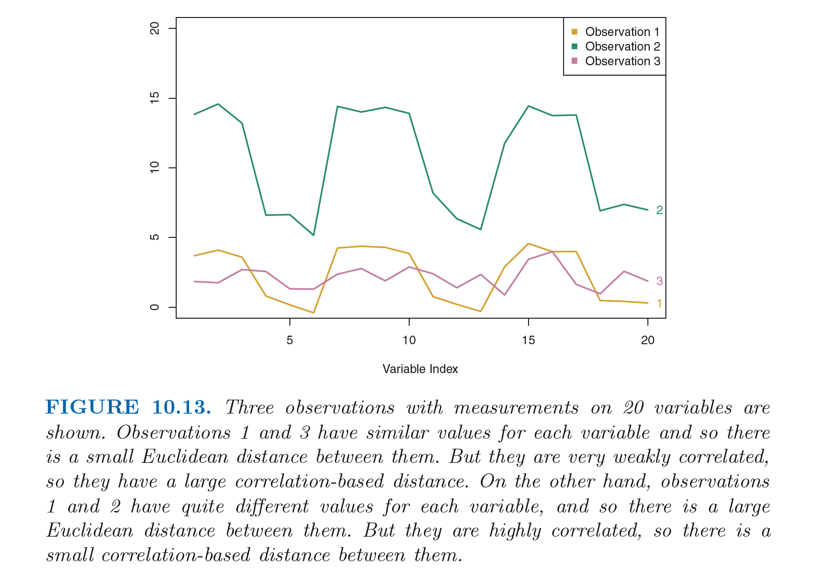
Dissimilarity measures

Slide 59
Dissimilarity measures

Slide 60
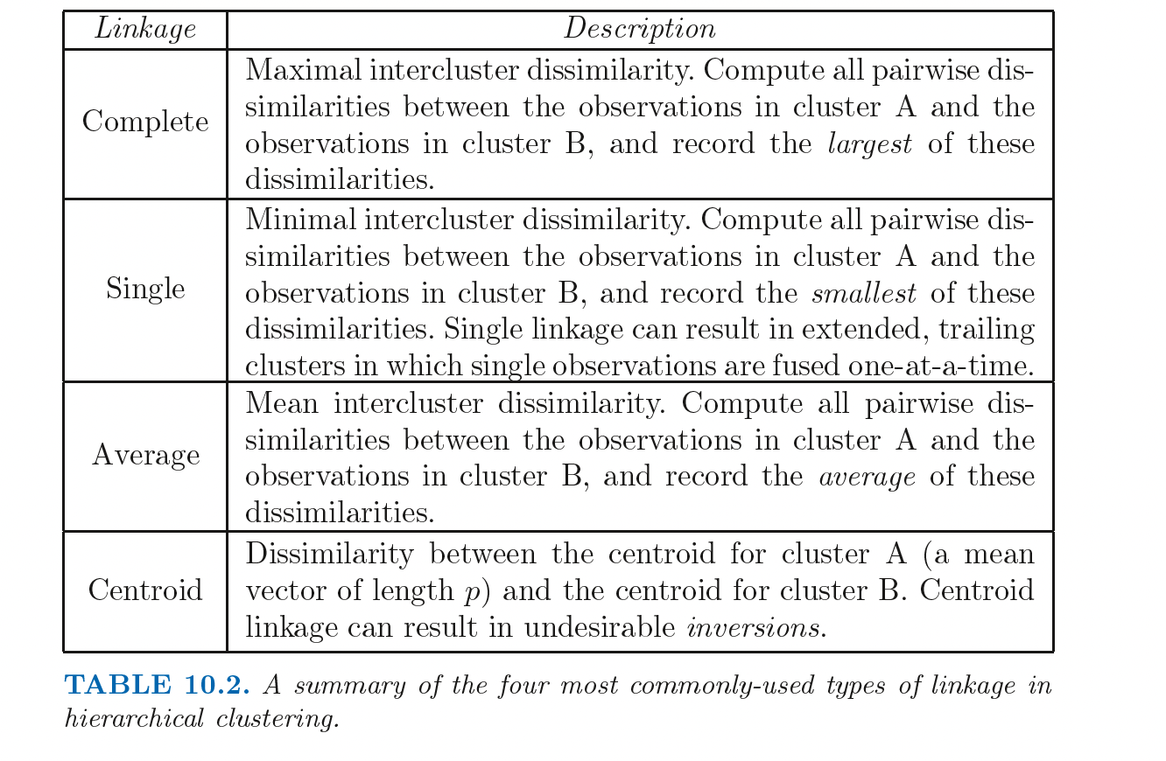
Dissimilarity measures

Slide 61
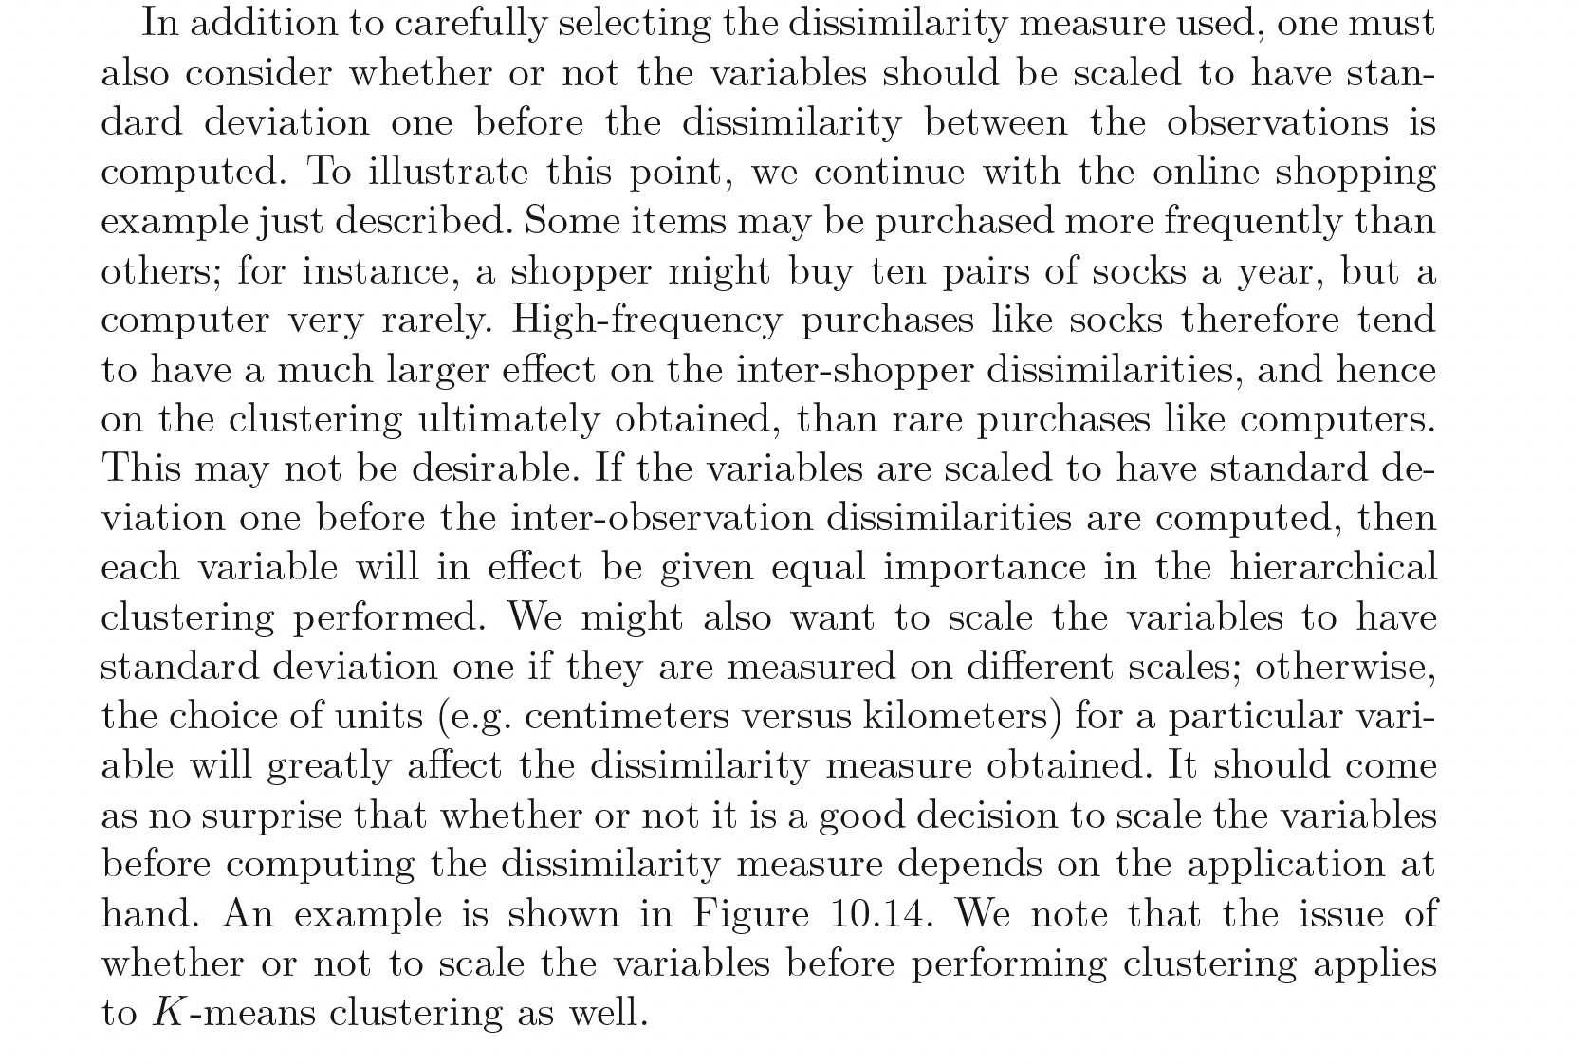
Scale variables/features

Slide 62
Comparing k means to Hierarchical
Advantage of k means over hierarchical:
Faster computationally.
Does not require choice of linkage.
Advantage of hierarchical over k means
Does not require number of groups to be known in advance.
No random seeds so more reproducible.
Does not assume spherical shape.
Slide courtesy Paul Fannon

Slide 63
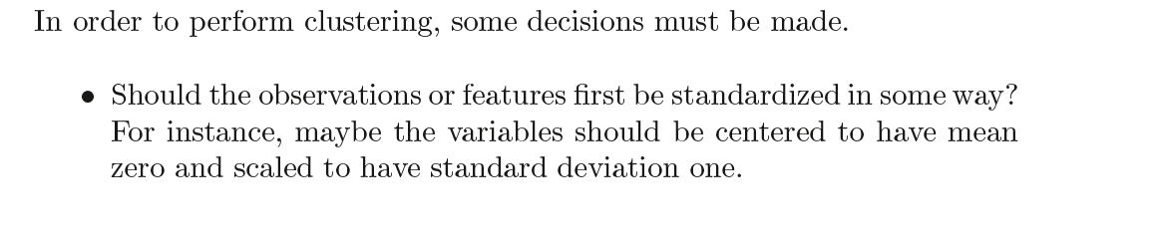
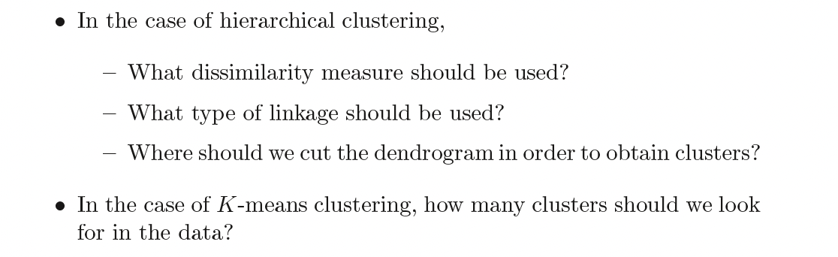
Decisions

Slide 64
Validating clusters
Validate clusters in external dataset
Hypothesis generation

Slide 65
Interactive explanations
https://mlu-explain.github.io

Slide 66
Resources
https://github.com/neelsoumya/public_teaching_unsupervised_learning
https://www.statlearning.com/

